Slide 1
Goal 5: Gender Equality
Research Report Update

Slide 2
Topic #1:
Preventing Violence and Discrimination based on Sexual Orientation and Gender Identity
Chairs: Aaron Chen (GE2, Head Chair) & Brian Lain (GE1, Deputy Chair)

Slide 3

Current Events Update
"More US Schools are Offering Safe Spaces for LGBTQ Youth"
Now 62% of US schools have LGBTQ support from administrators
Up 12% from 2010
90% of US schools have anti-discrimination policies
Up 2% from 2014
Less than half the schools offered psychological services for the community

Slide 4
Positions of key players
United States: Their newly passed “religious exemption” laws is partially discriminatory towards the LGBTQ community even though they are aiming for religious/cultural protection.
The Global increase in far right and fascist policies led to greater opposition towards the LGBTQ community, such as United States, Indonesia and Egypt. Therefore, this led to an increase in nation’s denial towards LGBTQ human rights.
Amnesty International is launching petitions to demand nations in granting LGBTQ community members that all humans deserve according to the UDHR. There’s one specific case regarding Northern Ireland currently on their website.

Slide 5

Blocs that may emerge
Islamic or religiously devout states may more likely work together
Ancient sacred texts may play a central role in their stances
Most European states may work together due to their general stance on pro-LGBTQ
Other member states with middle-ground stances may work together as well

Slide 6
Other Significant Info
Case Study of Tunisia: The campaigner of LGBTQ rights organization and broadcasting company had been assaulted and threatened for his actions. This is an example of anti-LGBTQ rights supporters using extreme methods to get deny LGBTQ community members their rights.
Relations to religious beliefs the extent of support in granting LGBTQ community members their rights is different for every religion. For example, Muslim communities often have a more difficult time accepting LGBTQ community member’s sexual identity.

Slide 7
Bibliography
https://www.huffingtonpost.com/entry/lgbtq-student-policies-us_us_5aa290f0e4b07047bec5b0ab
https://www.hrw.org/news/2018/02/19/united-states-state-laws-threaten-lgbt-equality
https://www.economist.com/news/middle-east-and-africa/21738921-new-online-radio-station-first-cater-arab-lgbt-people-gay-rights
https://www.amnesty.org.uk/issues/lgbti-rights
http://bestdelegate.com/forming-blocs-in-model-un/

Slide 8
Topic #2:
Implementing Literacy Programs for Women to Combat Inequality Universally
Chairs: Ariel Chen (GE1, Deputy Chair) & Emily Wang (GE2, Deputy Chair)

Slide 9
Current Events Update
OECD Countries Pulled Back the Gender Gap in Education
The Organization of Economic Co-operation and Development (OECD) is an IGO that has been working on reaching gender equality, education was included as one of the factor
In 2013, out of all students graduate from a general secondary education programme, 55% were girls
In 2013, 58% out of 6 million students across OECD countries who got bachelor’s degree are women
OECD has a focus on “March on Gender”, which has a goal of empowering women
Women’s education in both OECD and non OECD countries is one of the issues OECD is continuing to solve on

Slide 10
Positions of key countries
South Sudan had the least literate women rate in the world. Out of only 27% of literate men in South Sudan, only 14% of that are female (2009 est.).
Afghanistan stands right above South Sudan. With only 38.2% of total population that are literate, only 24.2% are female(2015 est).
Korea (North) held one of the most literacy rate of women. That is, 100% of its above age of 15 female population.

Slide 11

Blocs that may emerge
Countries located in Sub-Saharan Africa may work together due to similar conditions on this issue
Other countries with similar women literacy conditions may work together as well
Major MEDCs and leaders in literacy may work together with plans
Leaders in literacy may do researches on methods of their country combating illiteracy of women and may share it as the suggested solutions in blocs

Slide 12
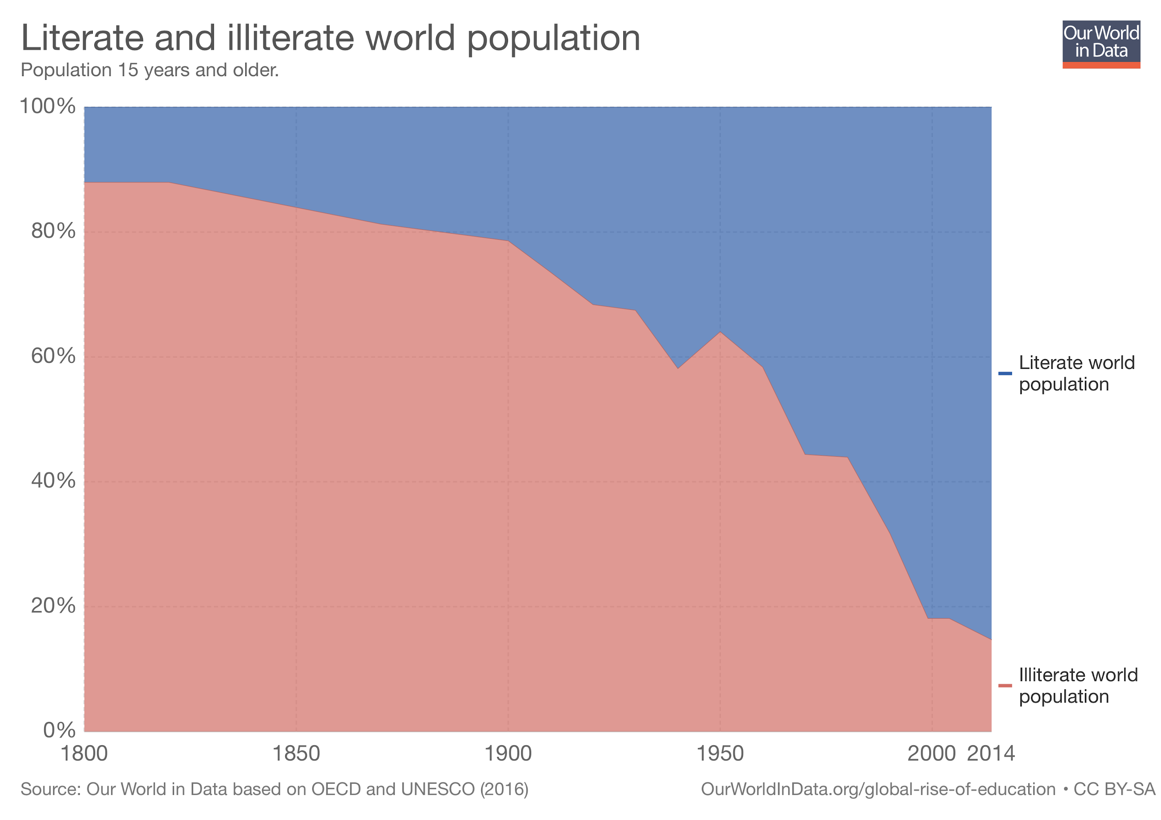
Other Significant Info
Although more are male, the illiteracy rate of world’s population had significantly decreased through late 20th century and 21st century.

Slide 13
Bibliography
http://www.oecd.org/gender/
http://www.oecd.org/gender/data/gender-gap-in-education.htm
https://www.cia.gov/library/publications/the-world-factbook/fields/2103.html#xx
https://ourworldindata.org/literacy

Slide 14
Topic #3:
Enhancing the use of Technological Development to Promote the Empowerment of Women
Chairs: Yan Ying Mor (GE1, Head Chair) & Mayte Romero (GE2, Deputy Chair)

Slide 15
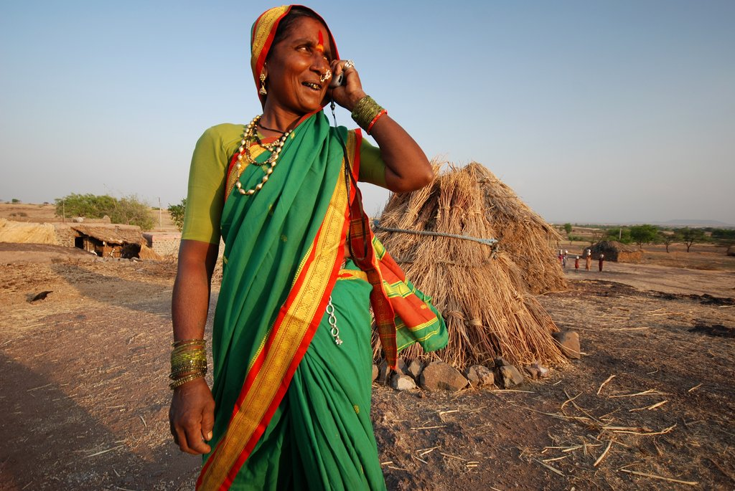
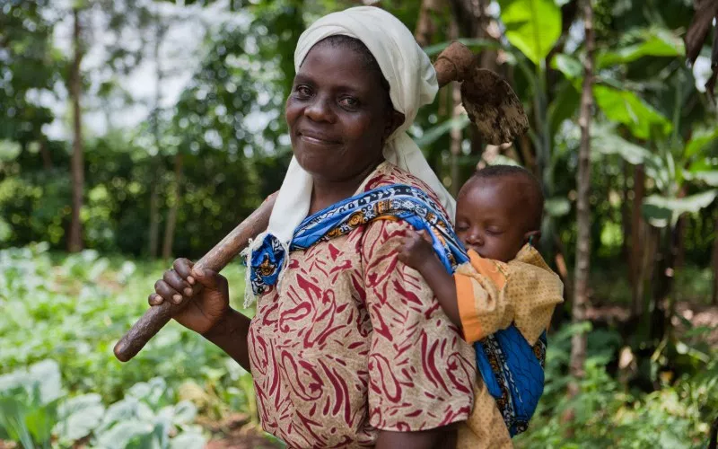

Current Events Update
International Women’s Day (3/8/18)
Further calls for the empowerment of women to achieve the SDGs
Theme: Rural and Urban Activists Transforming Women’s Lives
UN Commission on the Status of Women (CSW62) - 62nd Session on 14th of March
Climate change = affecting women in rural areas
Use of smart agriculture is crucial
Mali and Malawi
Agricultural policies + investments must consider the difference in access to resources for all genders
Mali = AgriFeD program = UN Women program
Skills training on agriculture

Slide 16
Involved Countries & their Actions
Country | Position/Actions
Ethiopia | Launching ICT development programmes to reduce infrastructure gap Helping small business owners to gain access to ICT services
Senegal | Technological Boom - more businesses using technologies Aims to increase female entrepreneurship
India | Emancipation of rural women for country’s development Economy = Rapidly growing Must work towards inclusive growth to reach equality
Mali | Climate-smart agriculture to lift females out of poverty Programs to spread the use of said technology UN Women training too

Slide 17

Blocs that may emerge
Countries in Southern Africa including:
Botswana, Malawi, Mozambique, Namibia, Seychelles, South Africa, Zambia, Zimbabwe
All beneficiaries of the FemBioBiz accelerator program
Develop skills for female business owners
Improve participation in STEM
Finland, Norway, Sweden
Higher gender equality
However, lesser percentage of women in STEM as compared to less developed countries
European Union countries
Germany, France ->Higher Gender Equality Index

Slide 18
Important Organizations
Organization | Description/Actions
UN Women | International Women’s Day Working along with local governments and ministries to improve women’s access to technology to increase agricultural productivity Mali and Malawi to develop technologies with UN Women South Sudanese government cooperation too
US Aid | Innovation for women’s empowerment Specifically tailor evidence to understand the needs of females More women in STEM as researchers,, entrepreneurs, etc.

Slide 19
Bibliography
“Climate-Smart Agriculture Paving the Way for Women's Empowerment in Mali and Malawi.”ReliefWeb, reliefweb.int/report/world/climate-smart-agriculture-paving-way-women-s-empowerment-mali-and-malawi.
IISD. “On International Day, UN Calls for Increased Progress on Gender Equality | News | SDG Knowledge Hub | IISD.” SDG Knowledge Hub, sdg.iisd.org/news/on-international-day-un-calls-for-increased-progress-on-gender-equality/.
“Gender Equality of Rural Women a Key Driver of Inclusive Growth in India.” The Financial Express, हिन्दी, 15 Mar. 2018, www.financialexpress.com/india-news/gender-equality-of-rural-women-a-key-driver-of-inclusive-growth-in-india/1099458/.
Girma, Zelalem. “Ethiopia: Quality Technologies to Hasten Inclusive Growth.” AllAfrica.com, 13 Mar. 2018, allafrica.com/stories/201803130795.html.
Lopez, Oscar. “Women Are Taking Charge in Senegal's Growing Tech Industry.” Mashable, Mashable, 12 Feb. 2018, mashable.com/2018/02/12/women-tech-senegal/#U5TGiom6XmqI.
Halpin, Hayley. “'A Gender Equality Paradox': Countries with More Gender Equality Have Fewer Female STEM Grads.” TheJournal.ie, www.thejournal.ie/gender-equality-countries-stem-girls-3848156-Feb2018/.
“Climate-Smart Agriculture Improves Livelihoods of Rural Women in Mali.” UN Women, www.unwomen.org/en/news/stories/2018/2/feature-story-climate-smart-agriculture-improves-womens-livelihoods-in-mali.
“International Women's Day.” The Rambler, 8 Mar. 2018, johnsonsrambler.files.wordpress.com/2013/03/iwd2013.jpg.
“Mann Deshi Entrepreneur Using Mobile Technology.” Global Giving, www.globalgiving.org/pfil/4375/Mann_Deshi_Entrepreneur_using_mobile_technology_Large.jpg.
“Women in Agriculture.” IMANI, 22 Aug. 2016, i1.wp.com/www.imaniafrica.org/wp-content/uploads/2016/07/women-in-agric.jpg?zoom=2&resize=800%2C500.
“International Cooperation.” European Data Protection Supervisor, edps.europa.eu/data-protection/our-work/subjects/international-cooperation_en.

